Slide 1

Analyzing the Wagner’s GROUP FOOTPRINT IN AFRICA
A study of the PMC Wagner Group operations in Africa
By Allan Freitas Brenner
ECON 8320

Slide 2
Overview
Data Source
Methodology
Description of variables
Findings
Pain points, struggles, and pitfalls
Conclusion
Q&A
Framework followed to complete the project
1

Slide 3

Data Source
Provided by the Armed Conflict Location & Event Data Project (ACLED):
Nonprofit created by Clionadh Raleigh, a political science professor at the University of Sussex.
ACLED collects information on the dates, actors, locations, fatalities, and types of all reported political violence and protest events around the world.
Data accessed via API (Free for students)
https://acleddata.com
2

Slide 4
METHODOLOGY:
Request
data via ACLED API
Apply
parameter (Actor1 = Wagner Group)
Build
data frame
Clean & Filter
data
Visualize
findings
Analyze
results
Steps taken to complete the study
3

Slide 5
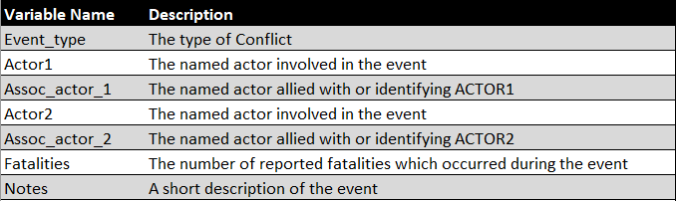
Description of variables
4

Slide 6
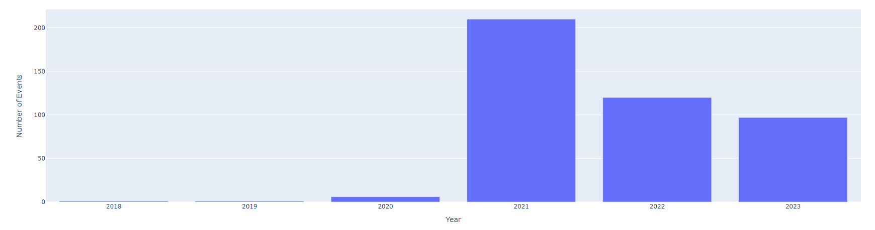
Findings: Number of events per Year
5

Slide 7
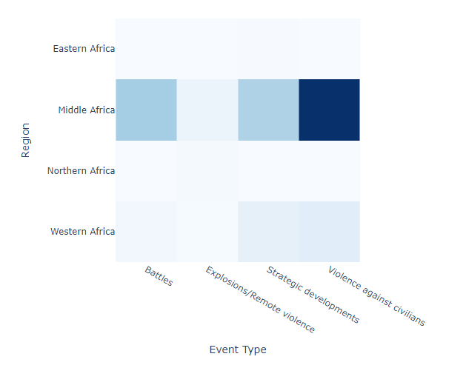

Findings: Event Type by region
6

Slide 8
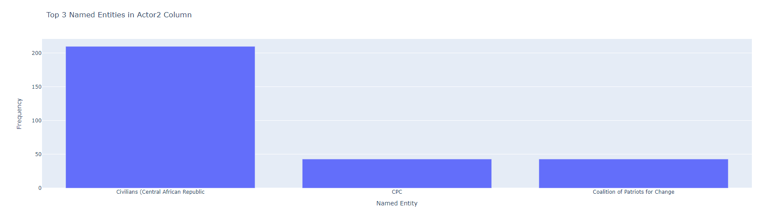
Findings: Who are the actors2?
The Coalition of Patriots for Change (CPC):
An opposition group that emerged in late 2020
Against the election and government of President Faustin-Archange Touadera
Composed of several armed groups including the Union for Peace in Central Africa
7
Source:https://en.wikipedia.org/wiki/Coalition_of_Patriots_for_Change#:~:text=The%20Coalition%20of%20Patriots%20for,21%20Central%20African%20general%20election.

Slide 9
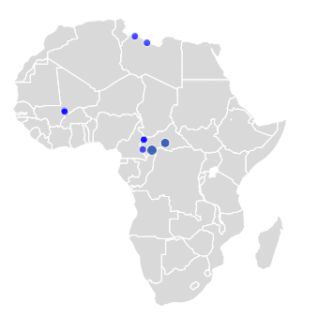

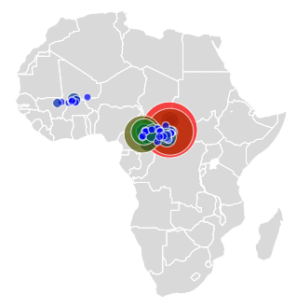

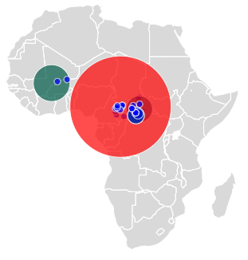

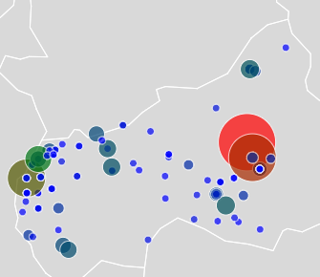
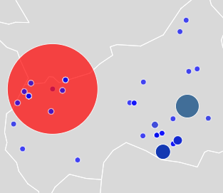
Findings: Fatalities ASSOCIATED WITH the Wagner’s group OPERATIONS
'On 17 November 2021, Russian mercenaries from Wagner Group attacked and clashed with CNLT militants at a CNLT military base in Pont Kogi location in the Ouham-Pende prefecture and near the border town of Gore in Chad (coded as Paoua). The clash was disclosed by a press release from the CNLT, with 27 rebels and around 100 civilians killed, around 127 fatalities in total.'
Explosions & Remote Violence
Violence Against Civilians
Battles
Refer to Appendix for details
The CNLT (Coordination of Movements for the Liberation of the Central African Republic Territories) is a coalition of armed groups in the Central African Republic (CAR) that emerged in 2021. The coalition includes several rebel groups, such as the Central African Patriotic Movement (MPC), the Union for Peace in the Central African Republic (UPC), and the Anti-balaka, among others – Source: https://en.wikipedia.org/wiki/National_Movement_for_the_Liberation_of_the_Central_African_Republic
8

Slide 10
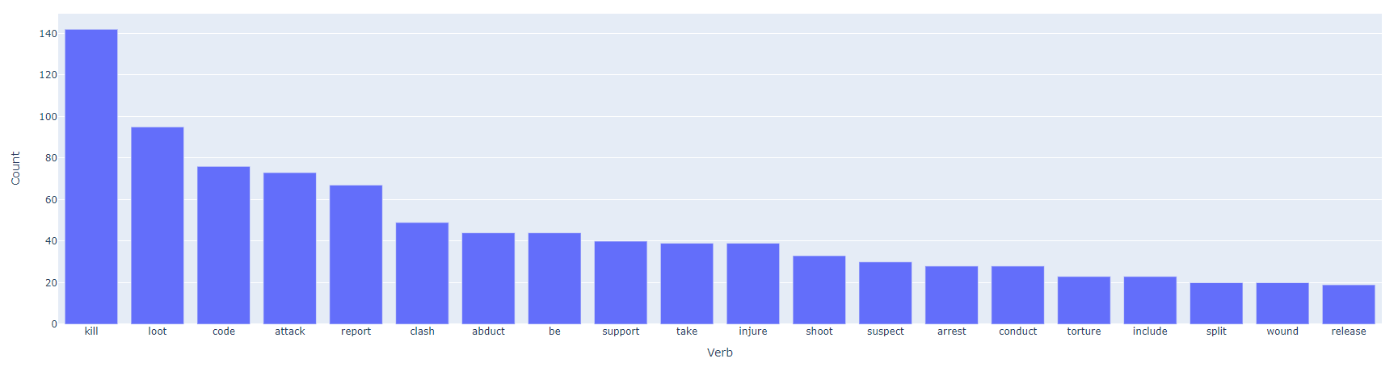
Findings: Top 20 most used verbs from event notes
9

Slide 11
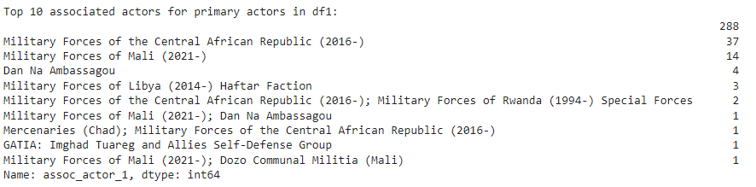
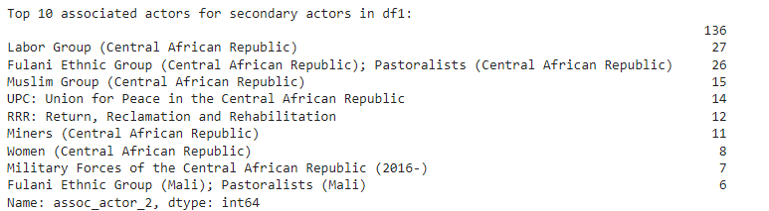
Findings: Associate Actors for primary Actors
DF1: API with parameter of Actor1 = Wagner
10

Slide 12
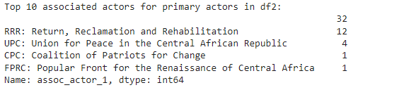
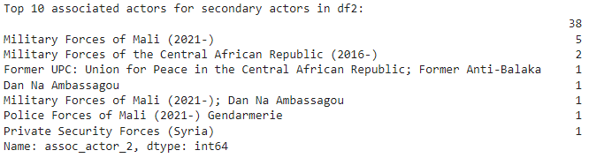
Findings: Associate Actors for primary Actors
DF2: API with parameter of Actor2 = Wagner
11

Slide 13
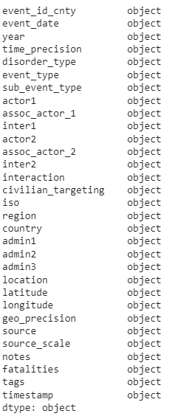
Pain points, Struggles, & PITFALLS
Unable to deploy “OR” parameter to API
Analysis only captures events in which Wagner Group is mentioned as Actor1
Data was all stored as objects (df.dtypes)
Multiple issues running into an incorrect data format
More exploratory data analysis prior to fully diving in
12

Slide 14
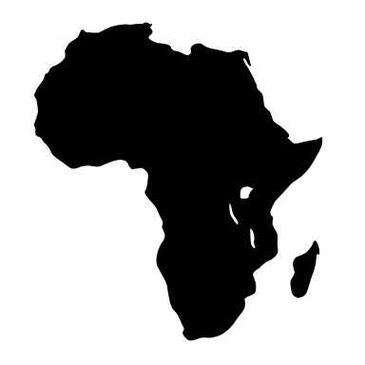



Conclusion
The Wagner’s group operations have been mainly targeted at Middle African countries, especially Central Africa and Mali.
The Wagner Group’s footprint in Africa is bloody and hostile, particularly toward civilians.
Associate actors suggest that the Wagner Group is working with African governments and their military forces.
13

Slide 15

THANK YOU!
14

Slide 16
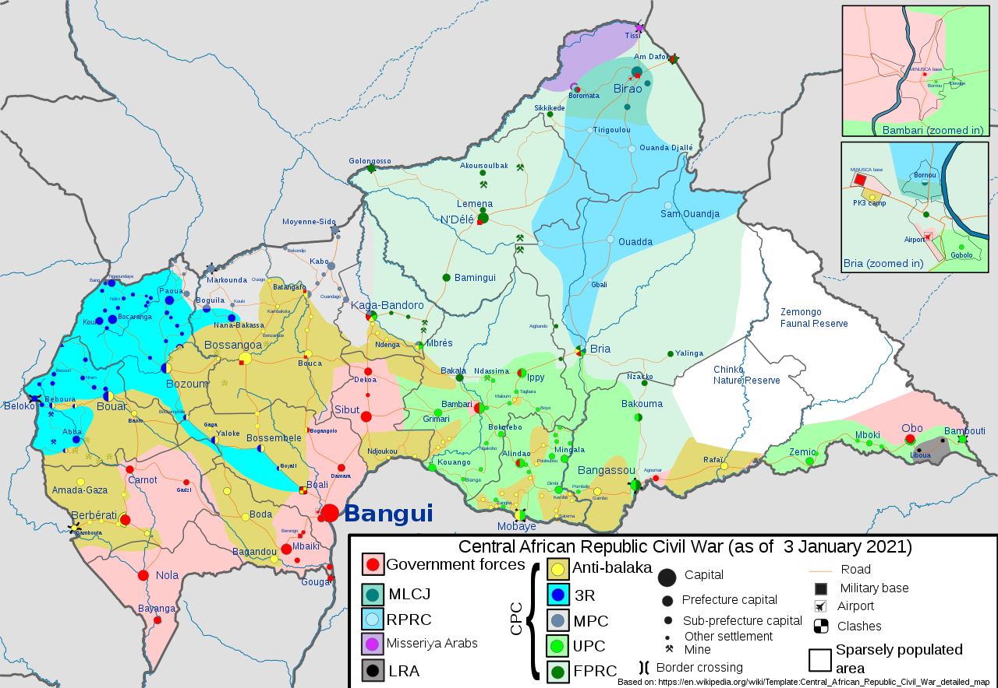
Appendix: The Geopolitical scenario in central africa
15

